Slide 1
ProCp - Project Core phase RCAEA Application
Richard Dyer Khan, Al-Mohaiminul IslaM
Tsanko Hadzhiev Khan, Raima
Zisis Damianidis Mihail Hadzhinikolov

Slide 2
Presentation Contents
RCAEA
RCAEA overview
key features
Benefits
Demo
Notes:
Slide 1 is team introduction Slide 2 AGENDA
Slide 3 Application introduction Slide 4 Describing one of the features
…
Slide 7-8 Demo
Slide 9 Conclusion

Slide 3
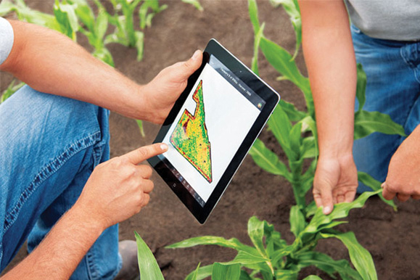
RCAEA

Slide 4


RCAEA overview
to simulate cultivating specific crop(s) in an area of land during a certain length of time
to use RCAEA in order to determine when, where, and what crops to place in a specified piece of land
Notes:
Explaining the one of the key features of the app

Slide 5

key features
Easy to Save simulation
Easy to load simulation
Easy to visualize crop growth
Easy to calculate harvesting cost
Easy to calculate the profit
Notes:
Explaining another key features of the app

Slide 6

Benefits
Efficiently using water resources
Efficiently using fertilizer
Efficiently using arable land
Minimizing harvesting cost
Maximizing profit
Notes:
Explaining another key features of the app

Slide 7

Enjoy RCAEA Demo!

Slide 8

Thank you

